Slide 1
Final Project Ontario College of Art and Design University CSDM-N151 Introduction to User Interface (UI) and User Experience (UX) Design
The Walk to Shop App
Ken Pink
May 18, 2023

Slide 2
The Problem
How can we help people who want to walk to go shopping but can’t because everything is too far away?
Many people would like to walk more because it is healthy and enjoyable.
A lot of people would like to walk to do various tasks to get stores and sellers but end up driving or just using transit because everything is too far for them to go.
Not using a car saves money and is good for the environment.
Unfortunately, many people cannot walk to their goods and services providers because they are too far away.
This app helps people find sellers that can be accessed without a car by showing seller locations and nearby walking routes.
near them, and where transit and walking routes intersect.
It gives people the ability to plan walking routes and how to access them using transit routes by transit and save (for offline use) routes, maps and schedules.

Slide 3
The Solution
The Walk to Shop app helps people find goods and service providers (sellers) that are accessible without a car.
It helps people plan carless routes to those sellers by showing walking and biking routes and where they intersect with transit routes.
Users can also save routes, maps and schedules for offline use.

Slide 4
The Concept
The Walk to Shop app is like AllTrails, TripLinx and Go Transit but for people who, want to be able to walk to go shopping.
This app would provide the location of sellers and service providers that have near by trails and paths that can bee accessed by transit.
This would be good for combining walking or biking with transit.
The app would provide the location or trails and paths with information about them, information about the sellers and service a, and a list of transit routes that intersect with the trails and paths.
A main feature of the Walk to Shop app is that maps and transit schedules can be downloaded/saved locally in the even that a walker does not have a cell phone signal while on one of their outing.

Slide 5
Persona

Slide 6
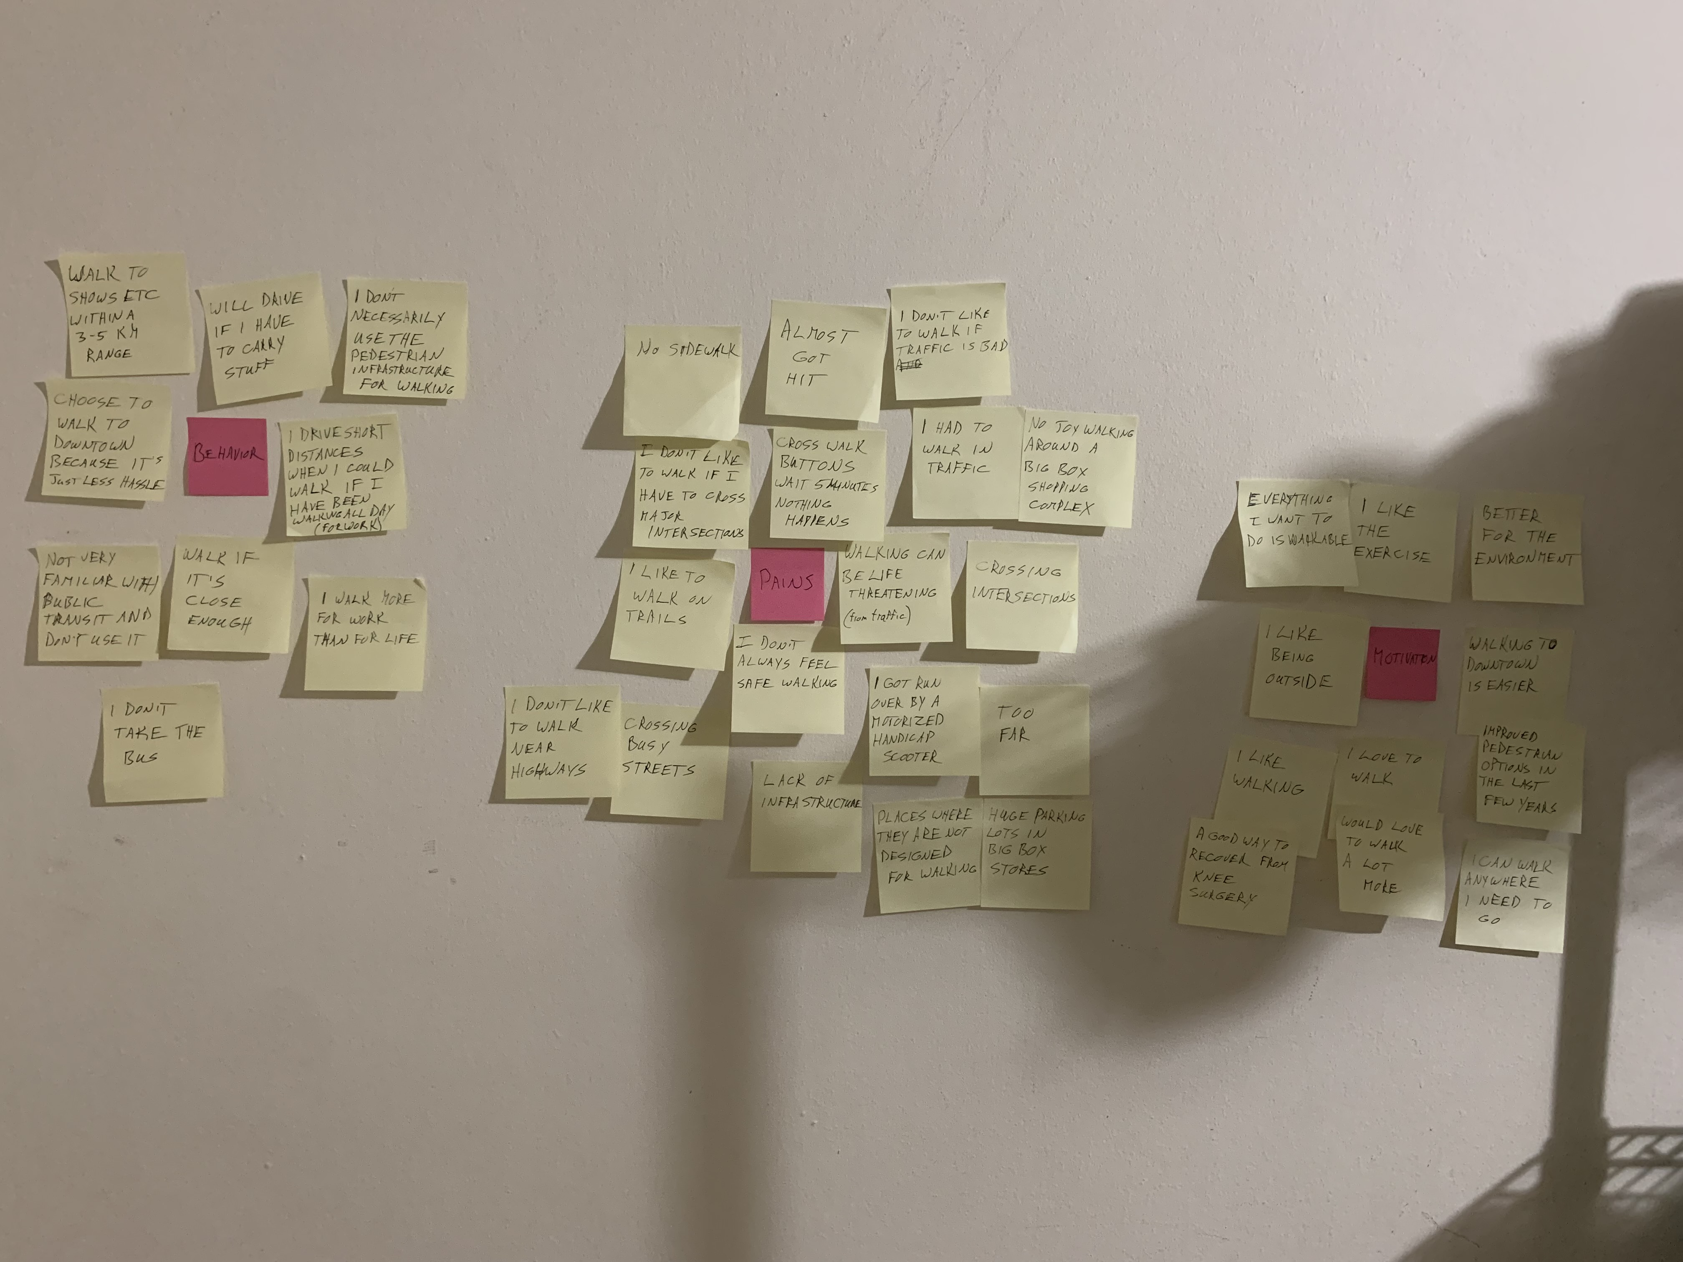
Research
I researched this project by doing the following:
Conducting four user interviews on the theme of: “What are the barriers to getting around your community by walking?” The survey questions are here
Do you enjoy walking?
Do you ever enjoy it/Not enjoy it?
Do you walk much?
How often do you walk?
Tell me about the last time you walked.
Why were you walking?
Where were you walking?
How long were you walking, or, how far did you go?
Was it a good experience?
Why or why wasn’t it a good experience?
What would have made you like it more or dislike it less?
Can you think of a time when you chose to walk even though there was another way you could have gone instead, such as bike, bus or car?
Why did you choose to walk?
Is there anywhere you like to walk?
Is there anywhere you don’t like to walk?
Is there anywhere you can think of that could or should be made better for walking?
If yes, where and how?
Do you ever walk to go shopping? What’s that like?
Reviewing the transcripts for themes and turning them into a low-fidelity diagram.
Researching existing apps that try to help with similar problems. Some of these included AllTrails, TripLinx and Go Transit.
Creating sketches of the app, turning it into a low-fidelity protype and then testing this with a selection of users.
Incorporating that feed-back into a final prototype and testing the results with users.

Slide 7
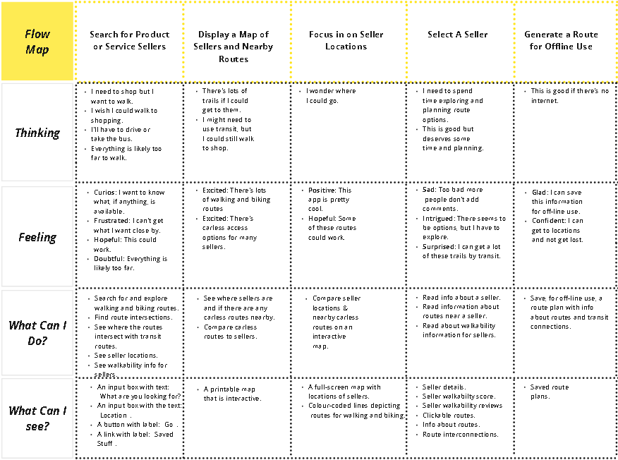
User Experience Map
The high-fidelity user experience map shown here was created following the user-experience mapping process described on the following pages.

Slide 8
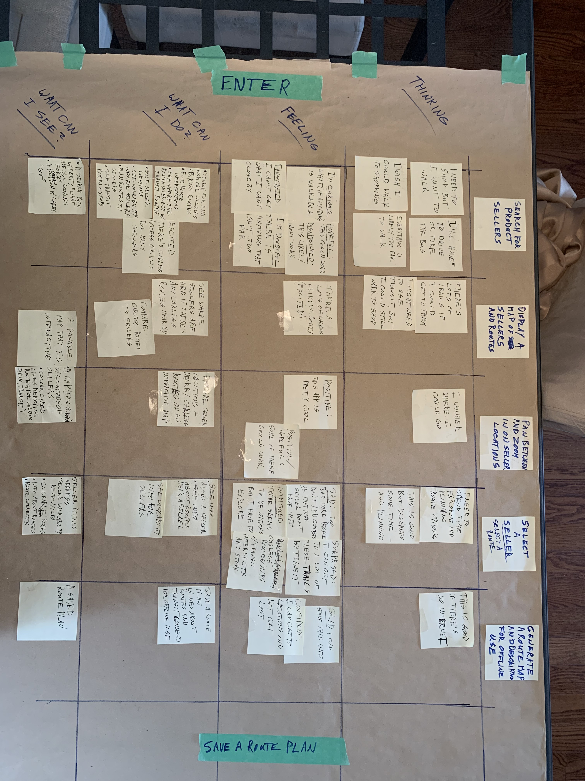
User Experience Mapping Process
After conducting user interviews, creating an affinity diagram and defining a problem statement, I made a low-fidelity user map of the most common task to be performed by a user: searching for sellers and routes.

Slide 9
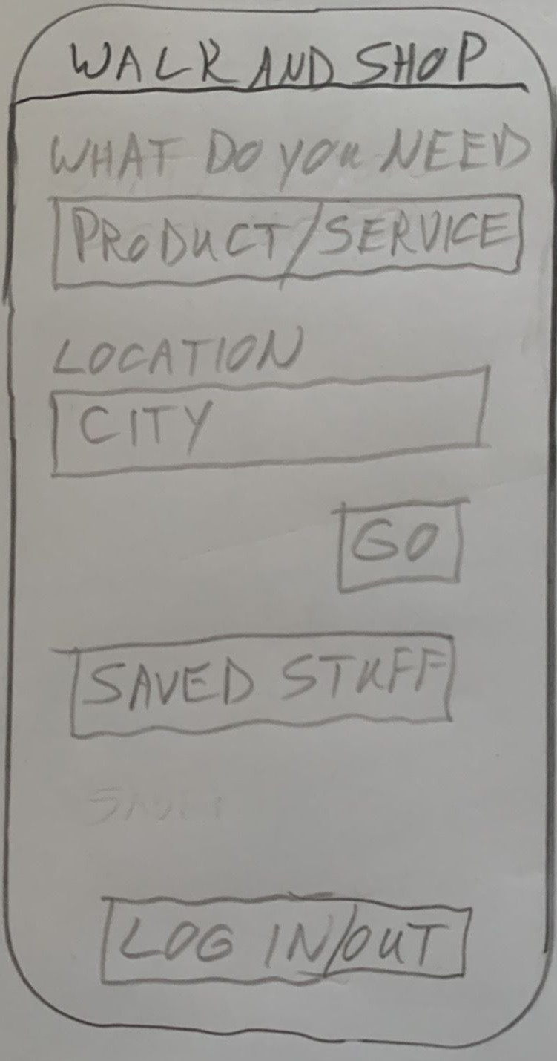
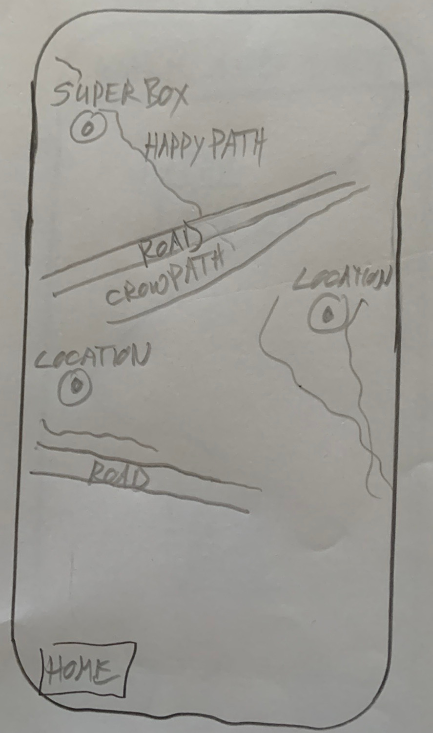
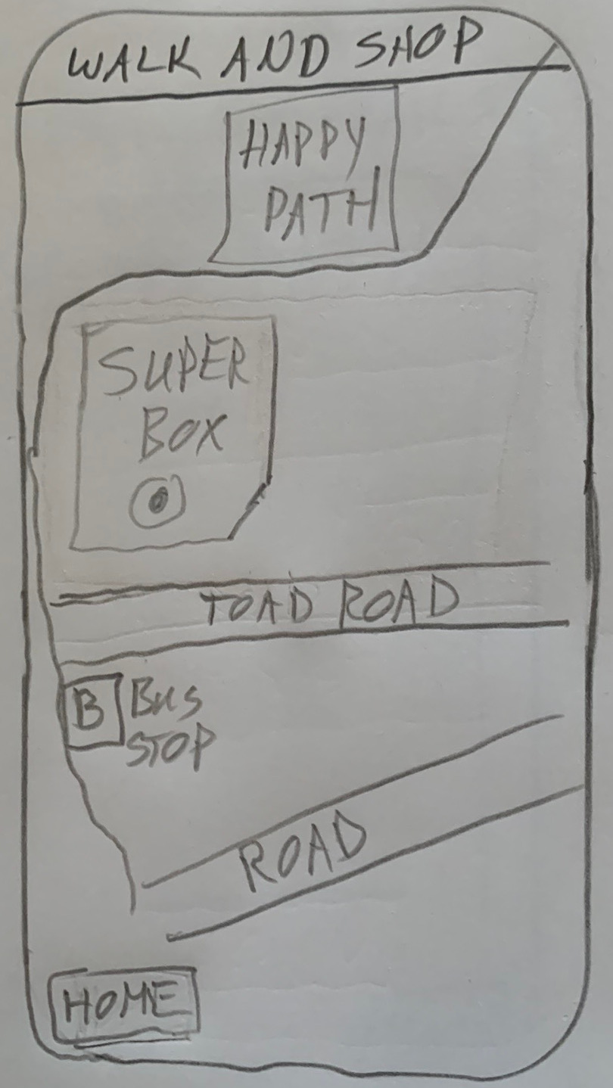
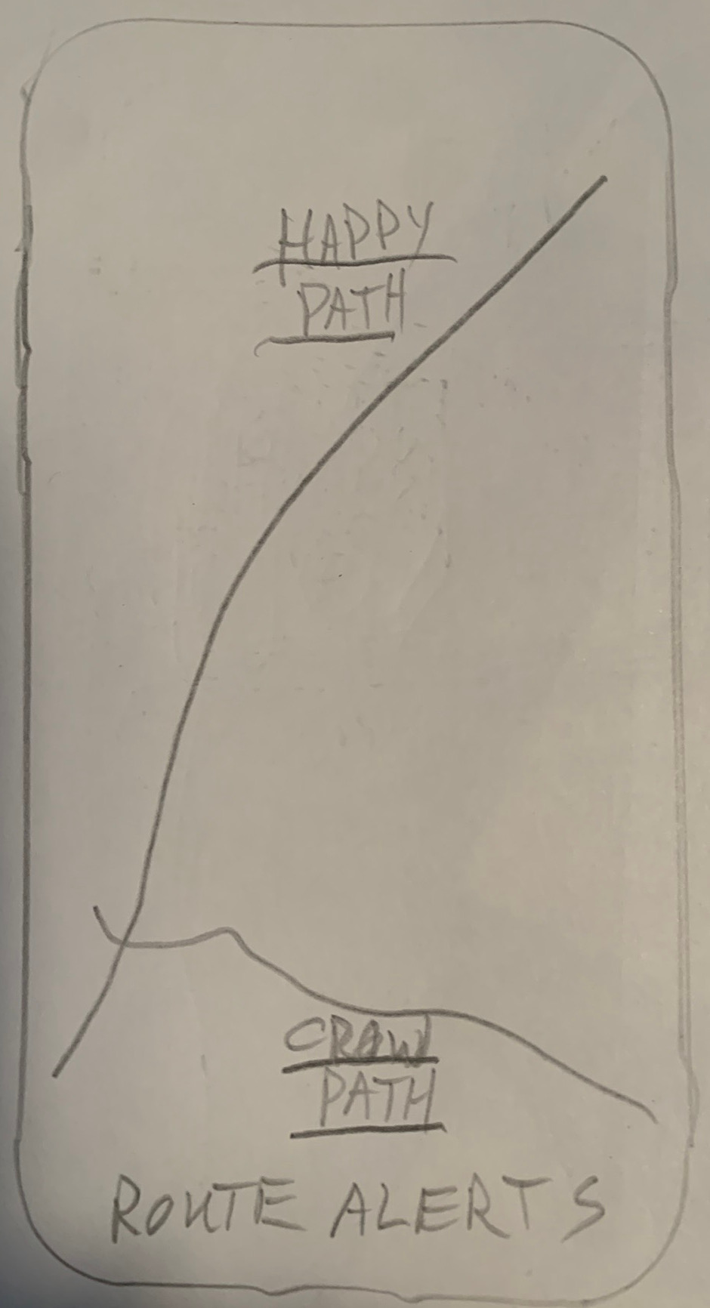
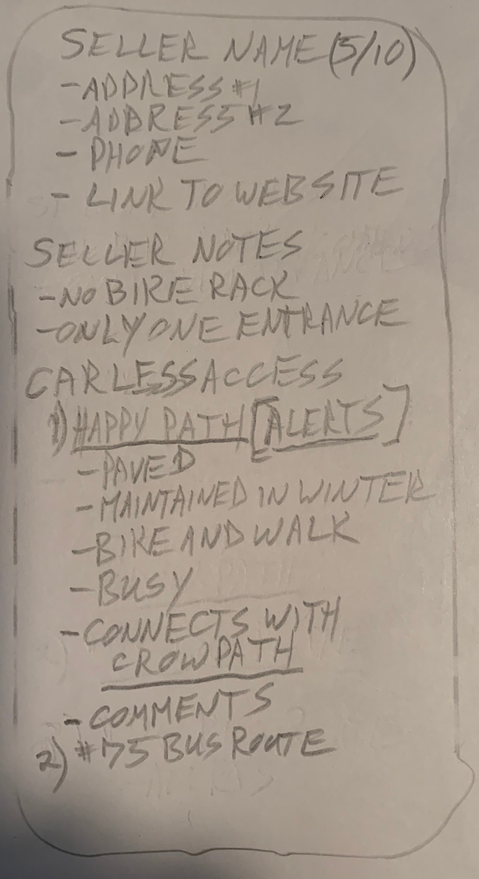
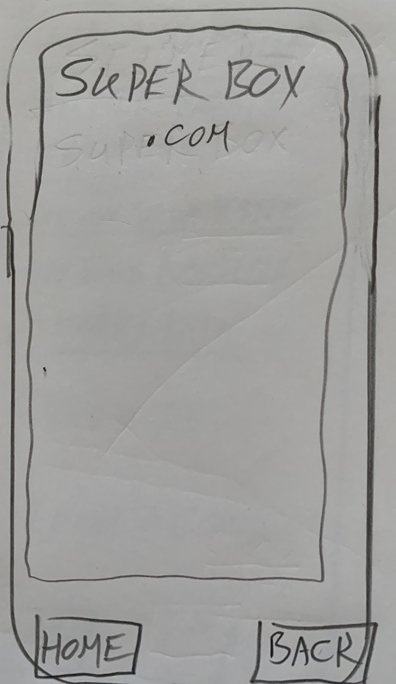
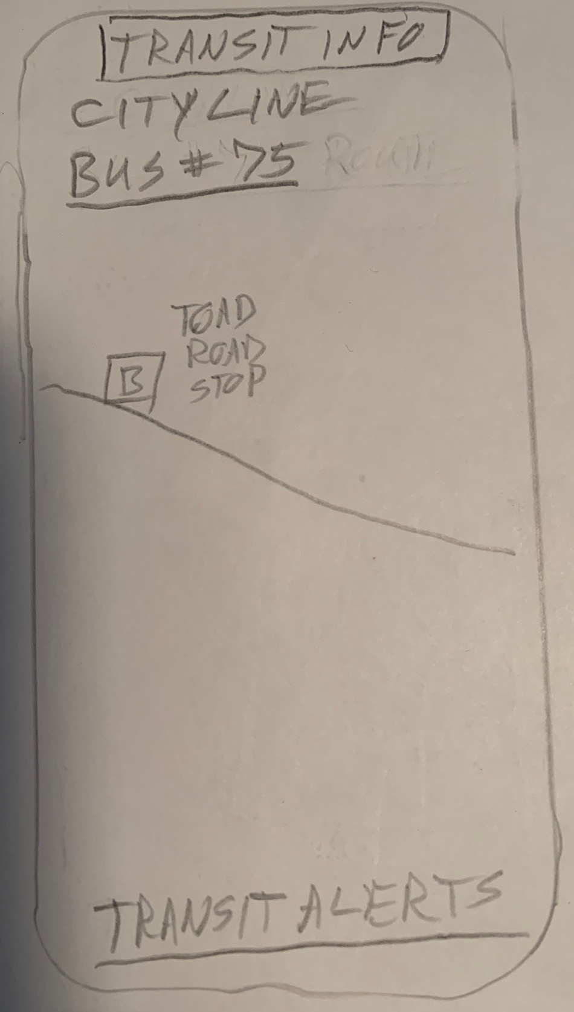
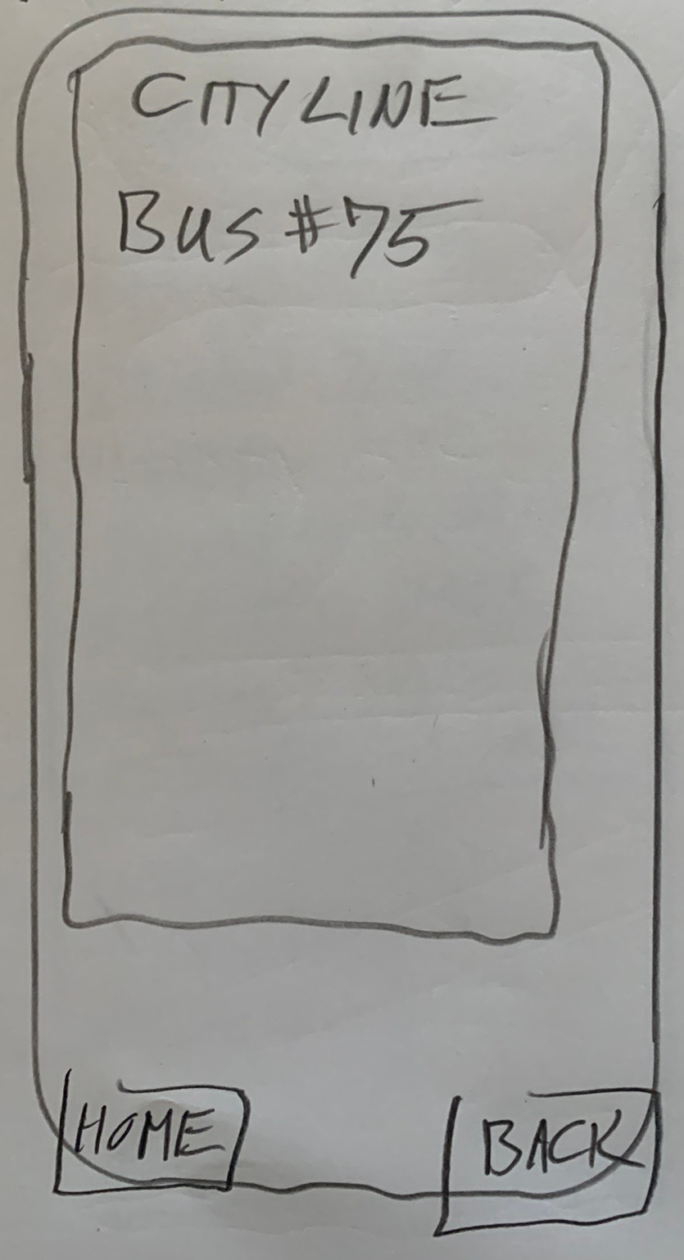
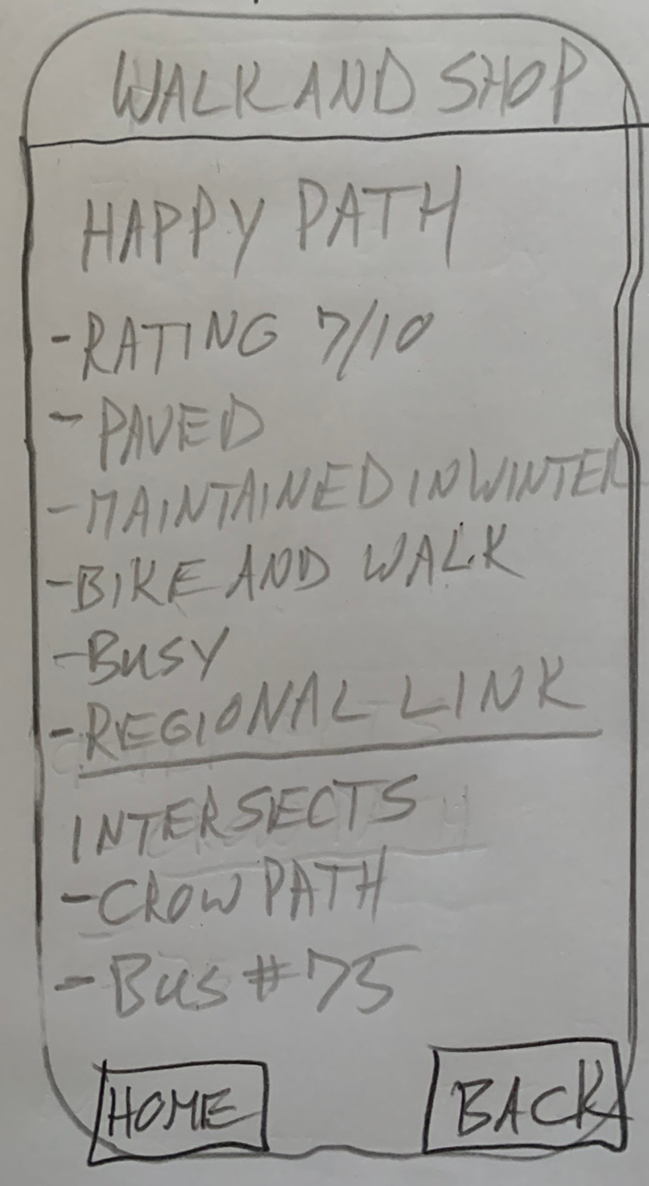
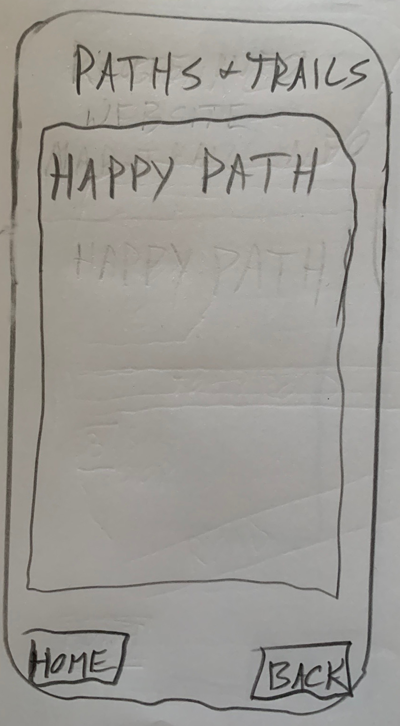
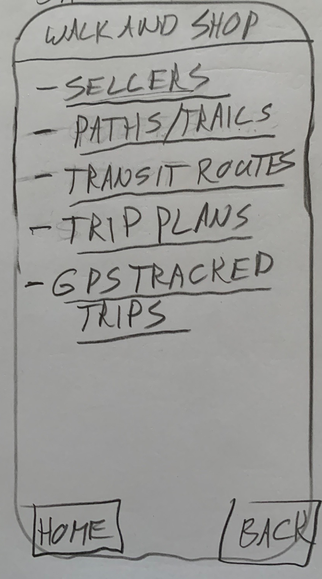
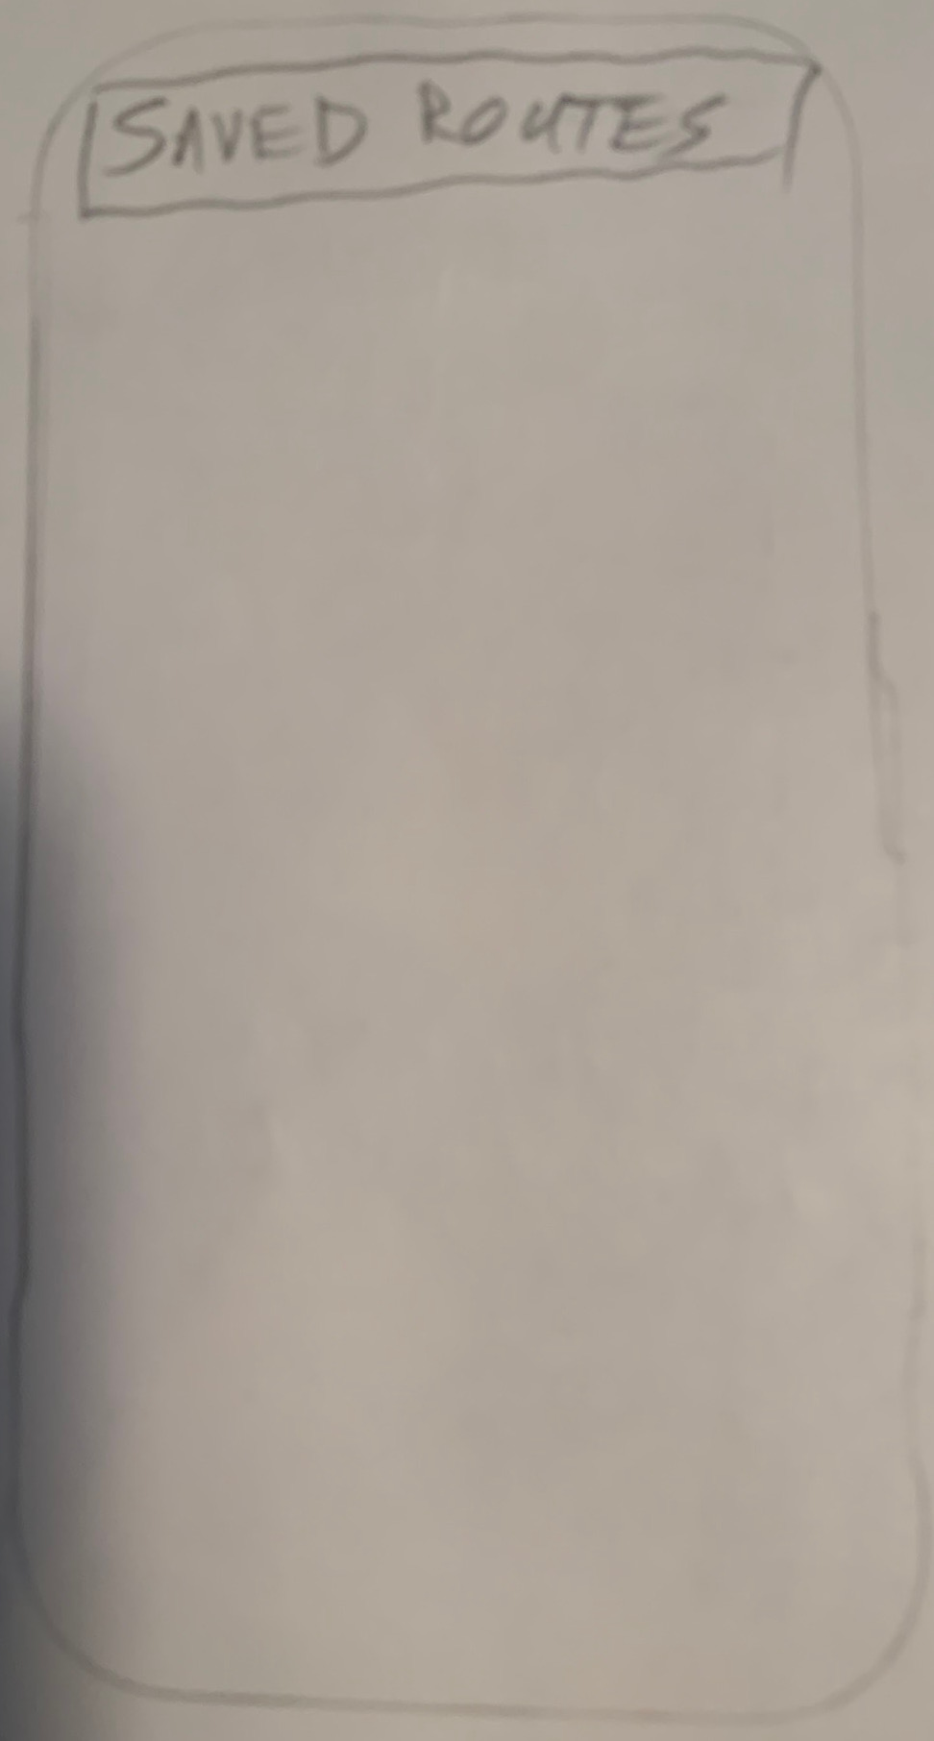
User Experience Mapping Process
I then made these low-fidelity sketches of the app.

Slide 10
User Experience Mapping Process
I then turned them into a low-fidelity prototype using Marvel POP and presented it to my user testing group for feedback.
After getting feedback I turned this into a high-fidelity user experience map.

Slide 11
Most Important Workflow
The most important flow in the app is the search results presented to users after they have searched for a type of seller.
The search displays locations of sellers and nearby carless routes.
Users can then pan/slide between and zoom in on the sellers to see the routes that are close by.
Users can also click on the sellers and the routes to get more information about each.

Slide 12
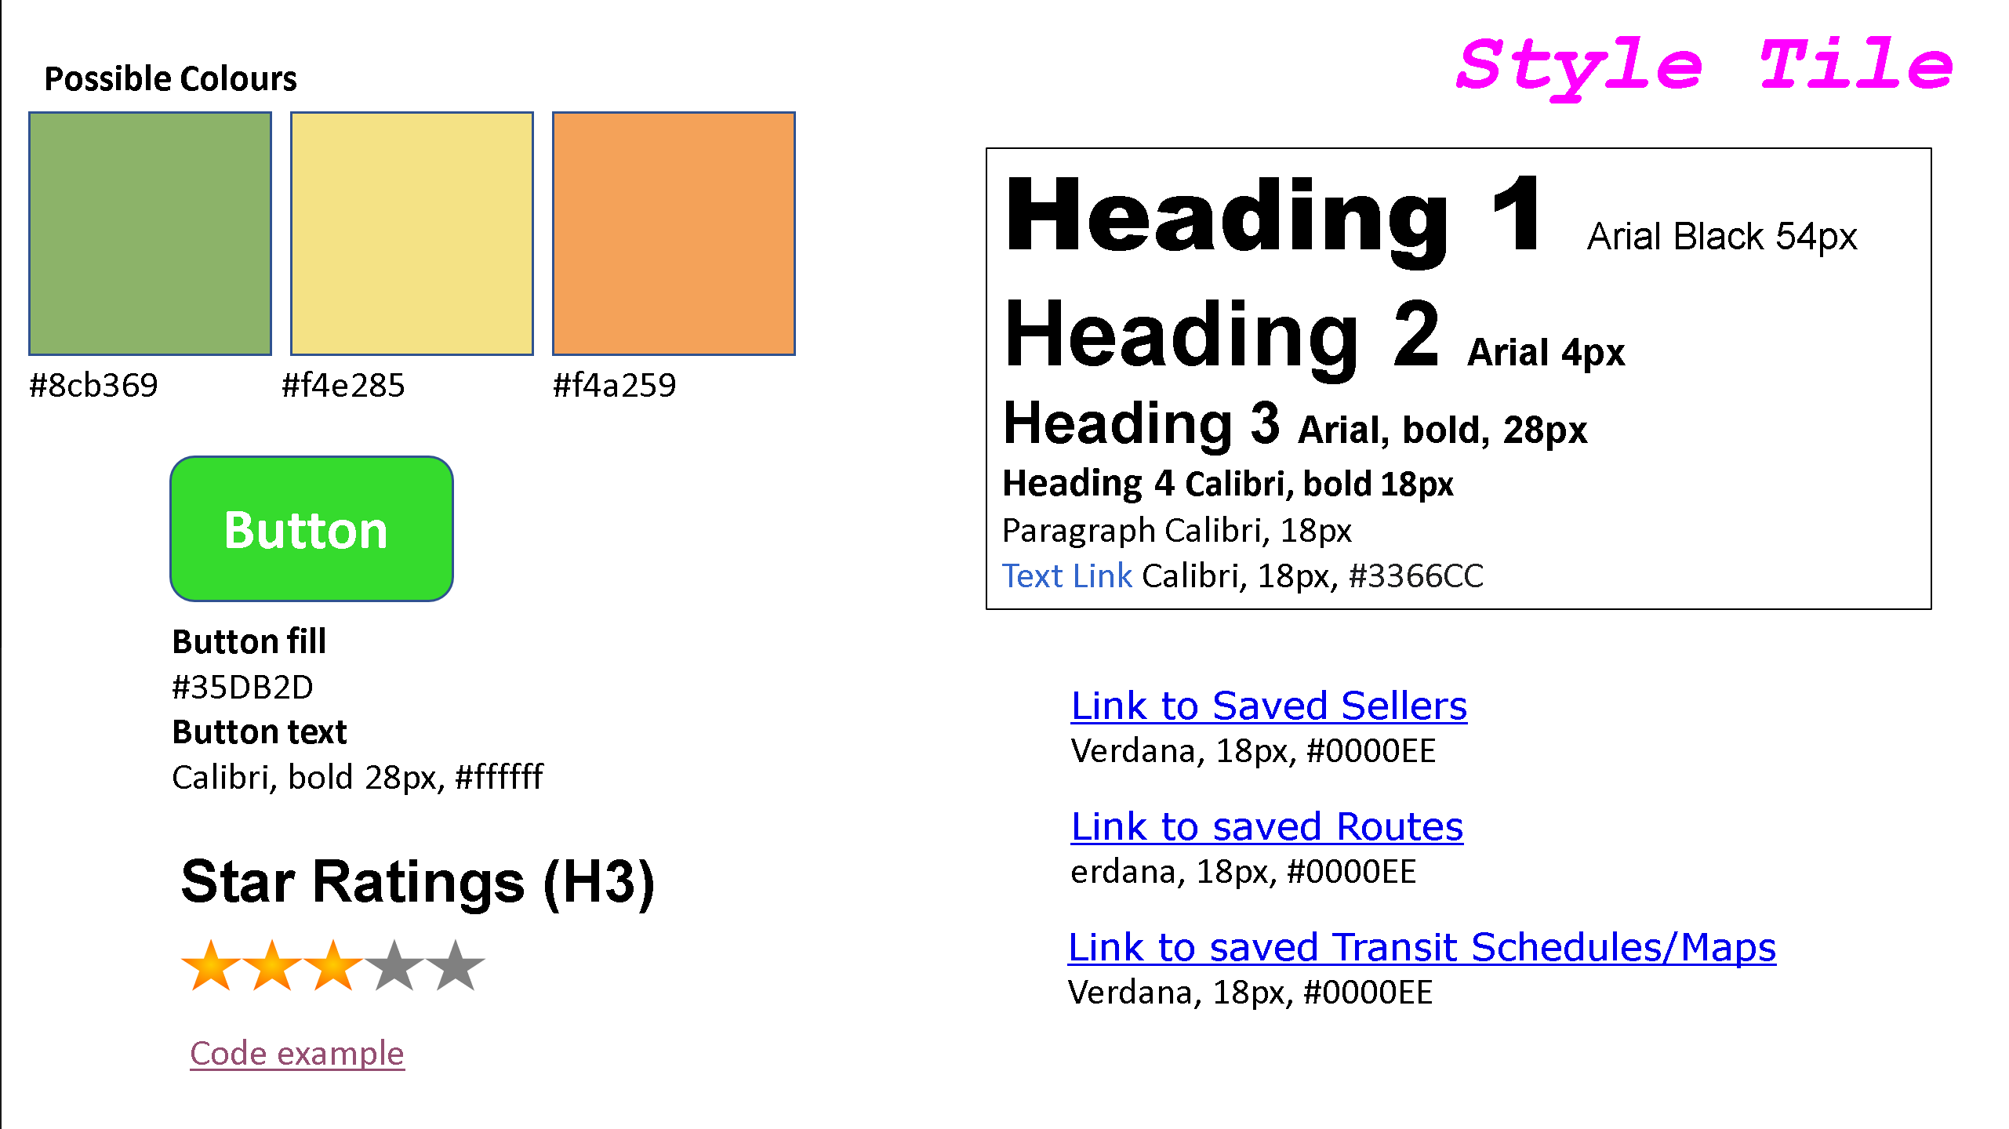

Slide 13
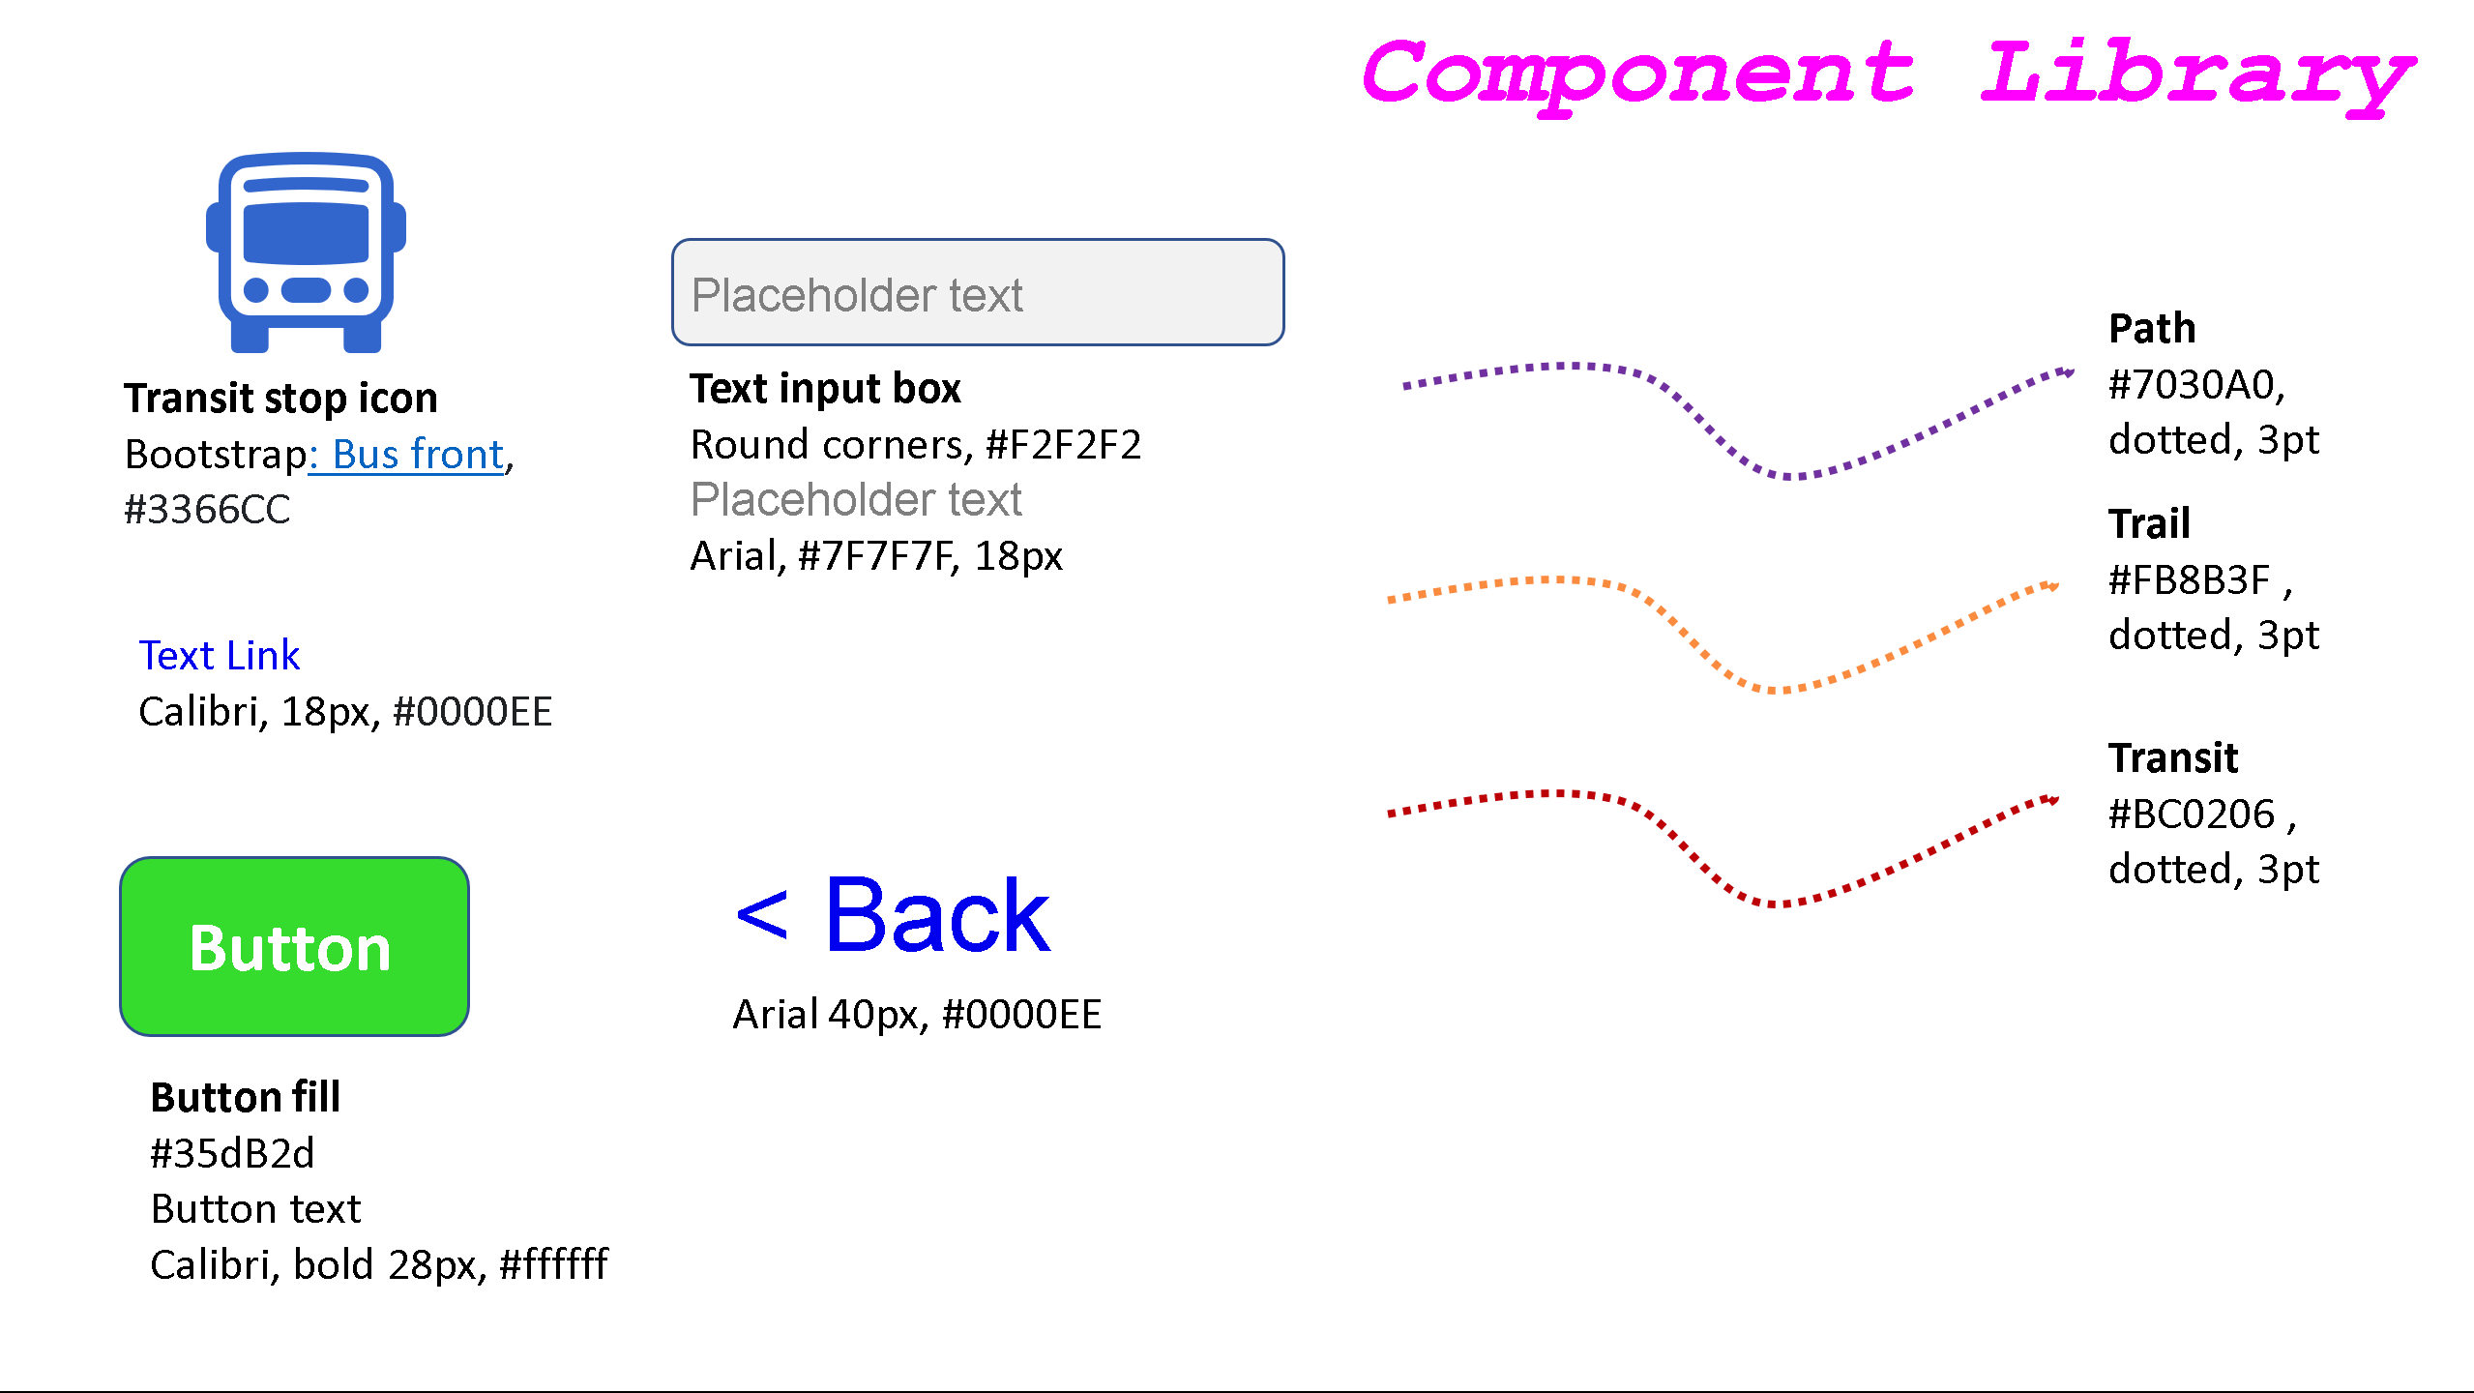

Slide 14
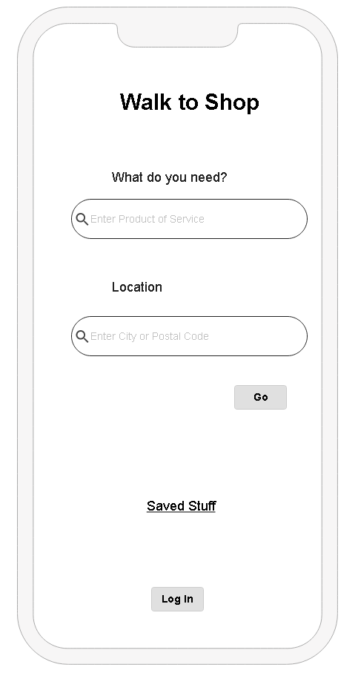
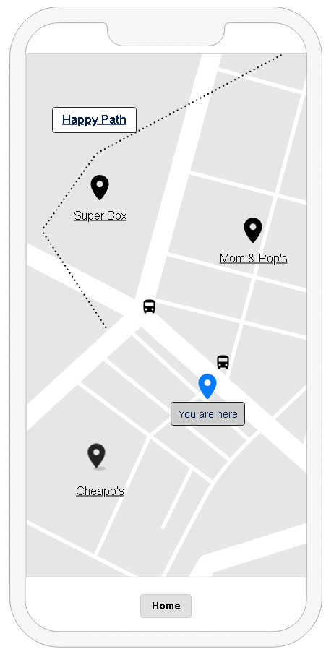
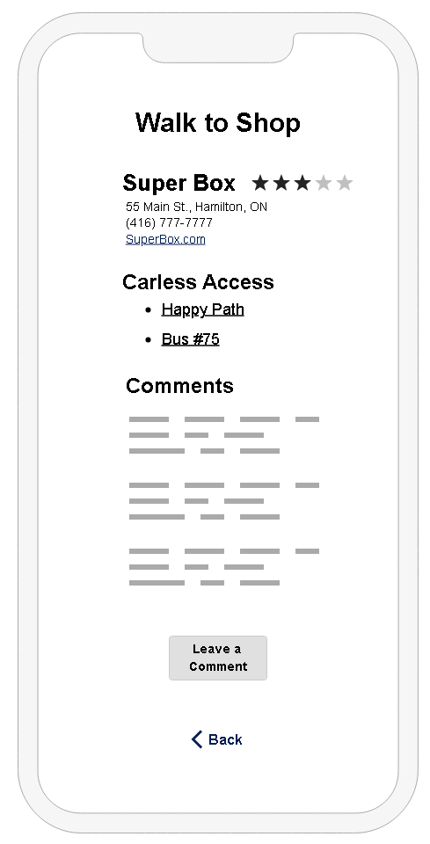
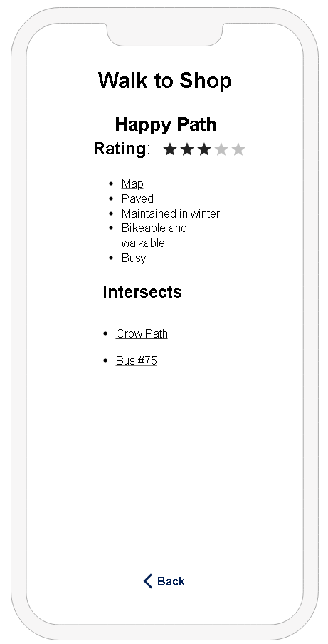
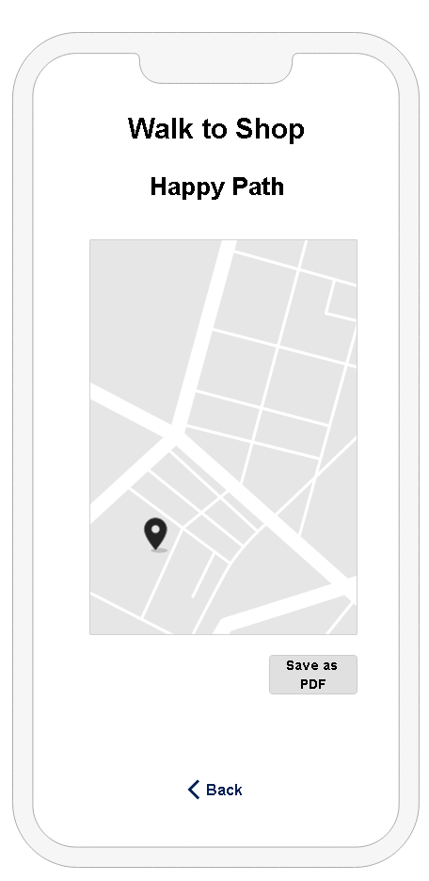
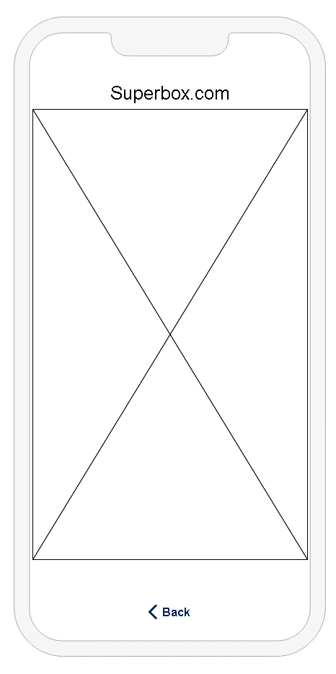
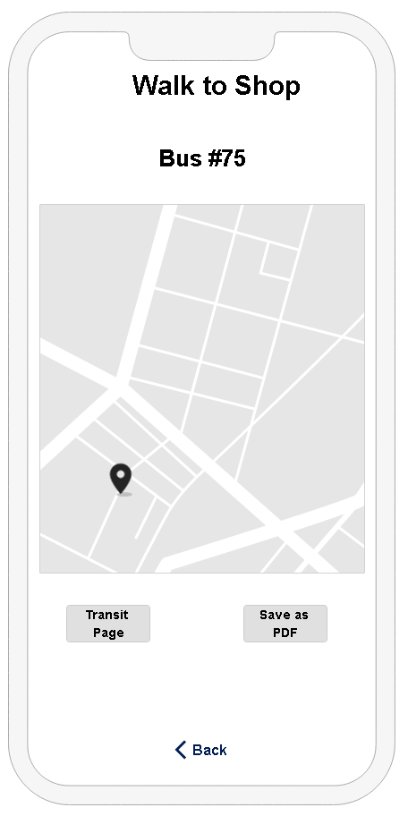
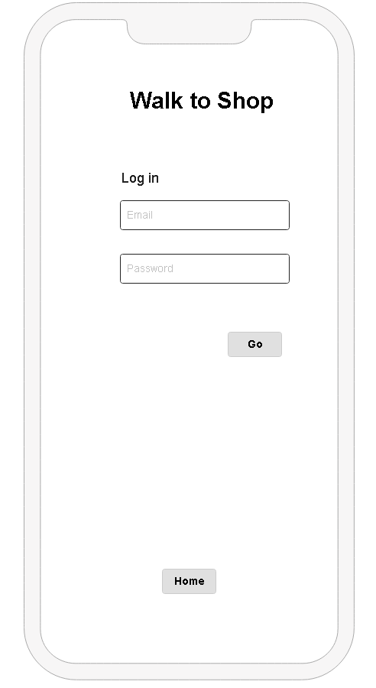
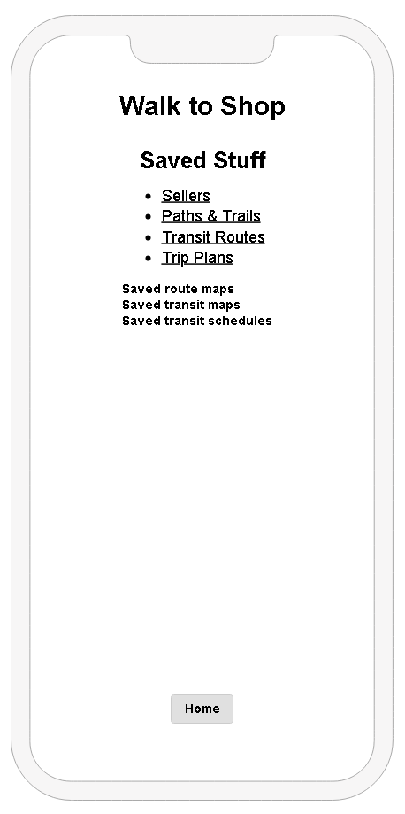
Wireframe Map

Slide 15
Wireframes 1 - 3

Slide 16
Wireframes 4 - 6

Slide 17
Wireframes 7 - 9

